Slide 1
Chapter 5 Greedy Algorithms
School of Science, Yanshan University
Wang Gang

Slide 2
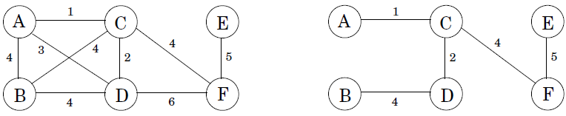
Minimum Spanning Tree
Minimum Spanning Tree (MST):
Tree: connected, undirected, acyclic;
connected, undirected, n-1 edges;
a unique path between any pair of nodes.

Slide 3
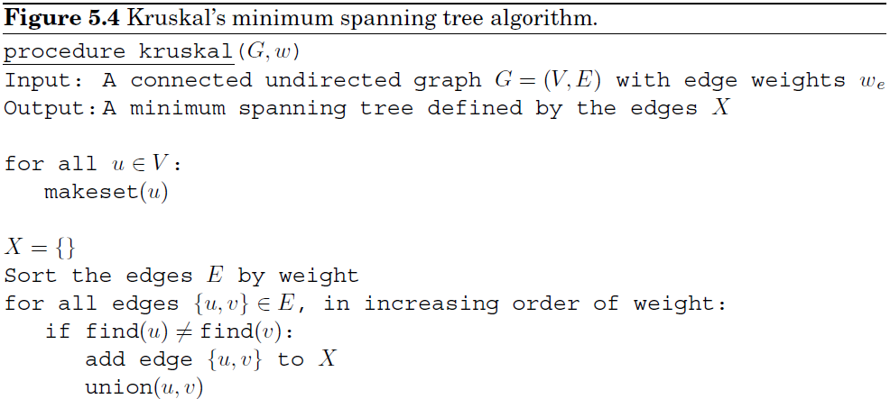
Minimum Spanning Tree
Greedy Kruskal: repeatedly add the next lightest edge that doesn't produce a cycle.
avoid cycles

Slide 4
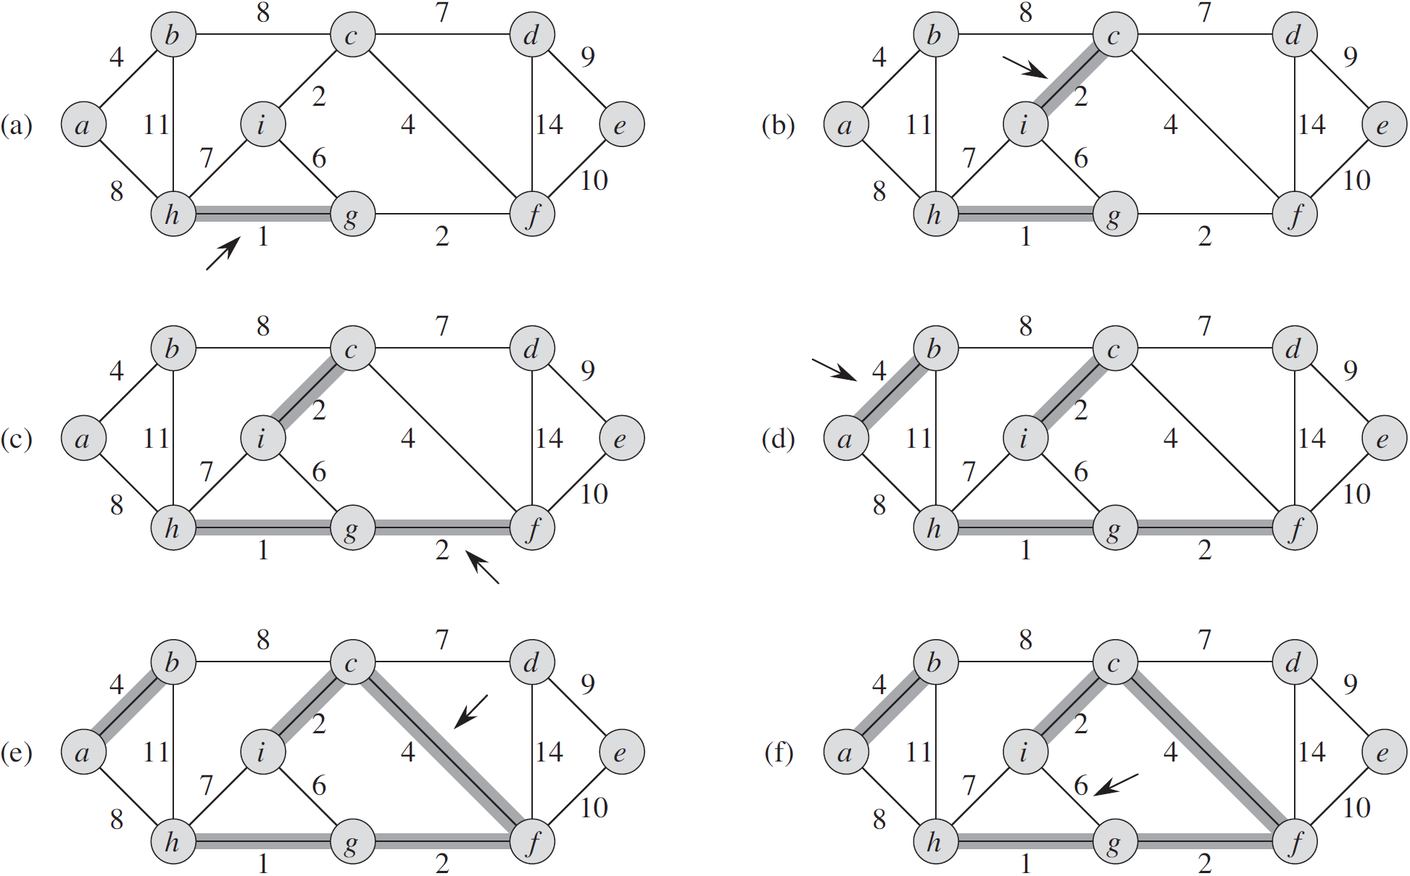
Minimum Spanning Tree
Kruskal's algorithm:

Slide 5
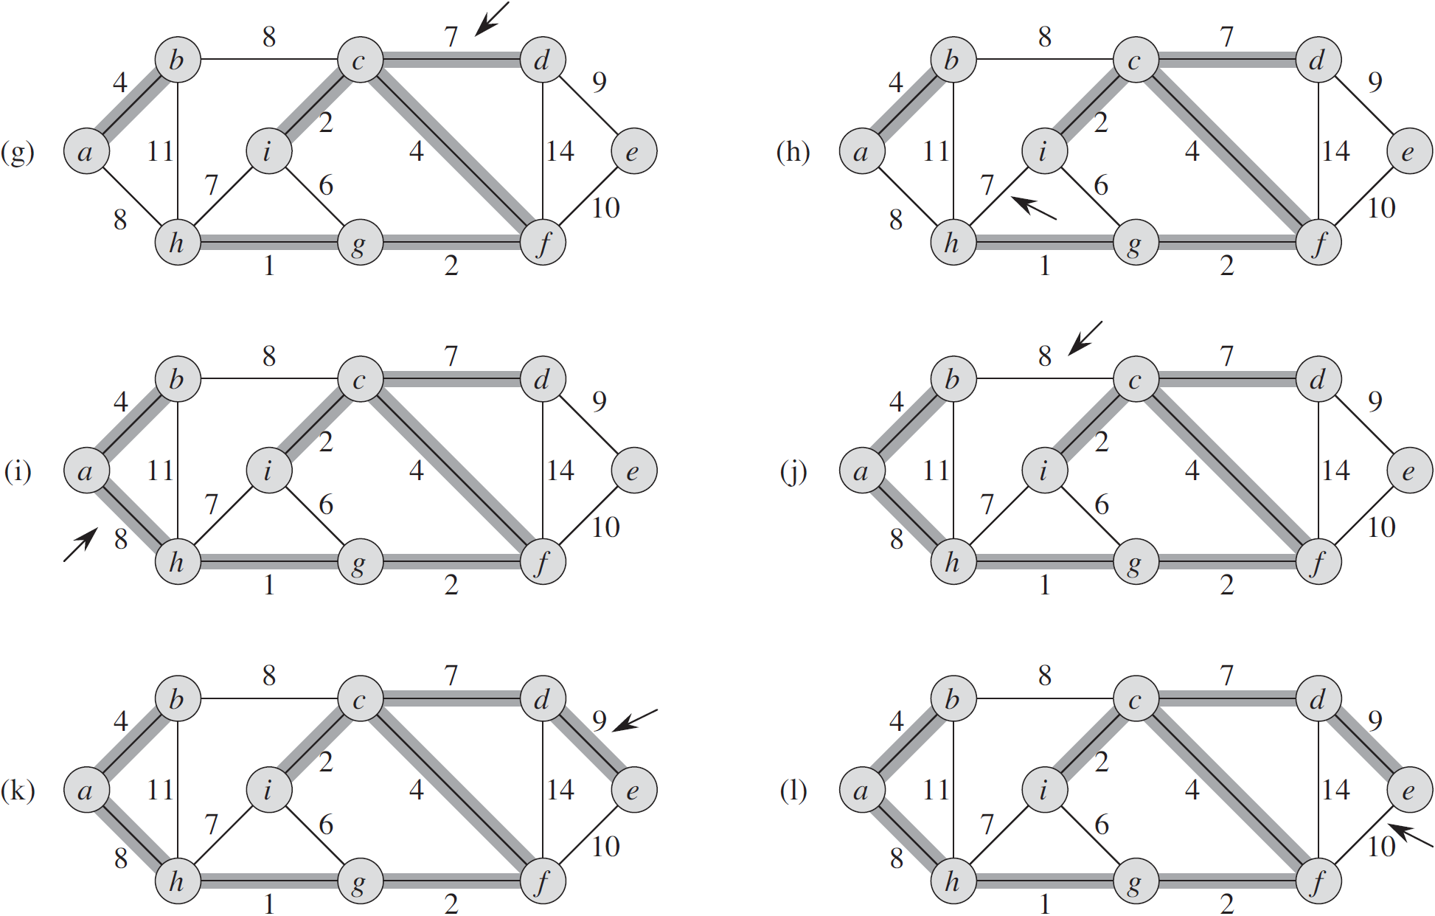
Minimum Spanning Tree
Kruskal's algorithm:

Slide 6
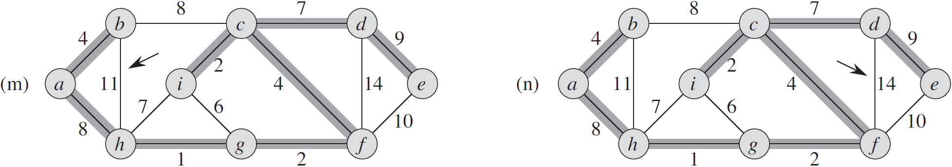
Minimum Spanning Tree
Kruskal's algorithm:

Slide 7
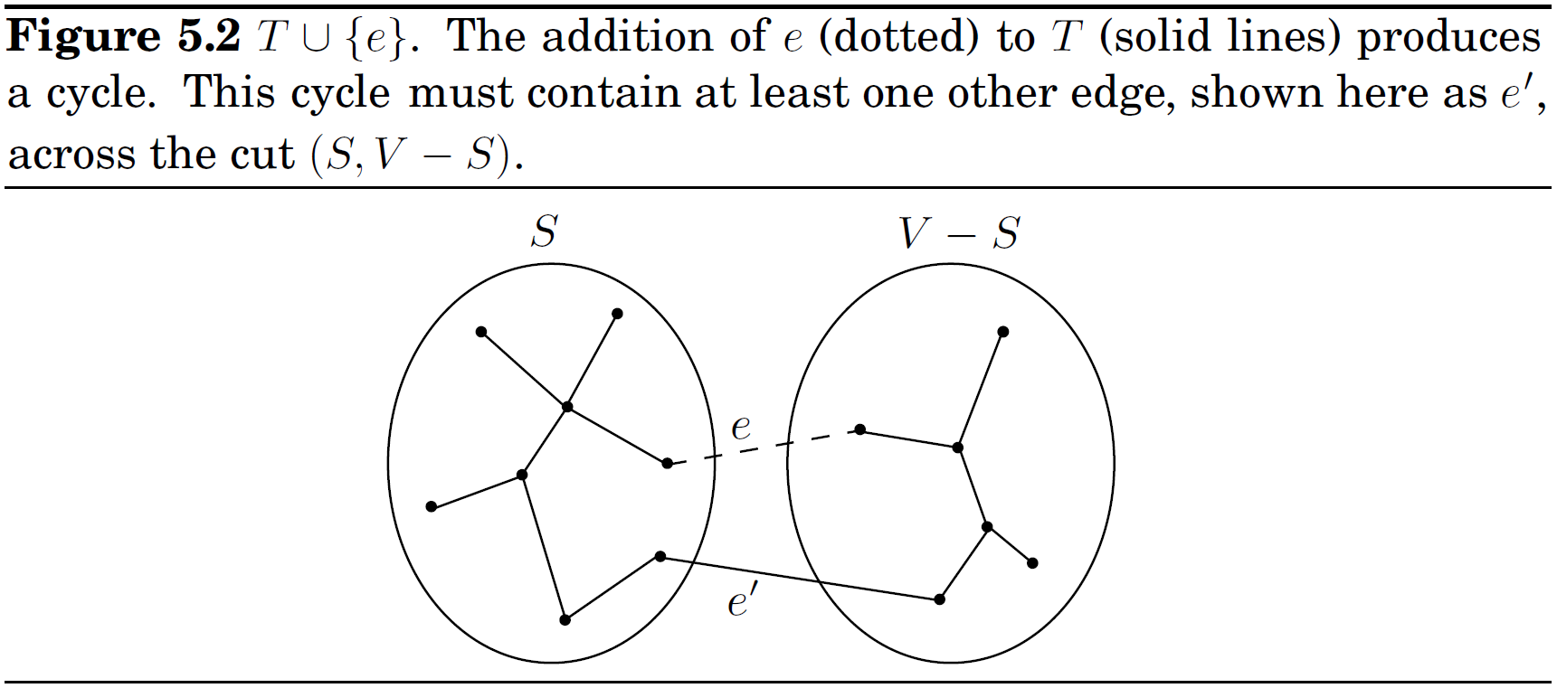
Correctness of Kruskal's algorithm
Cut Property. Suppose edges X are part of a minimum spanning tree of G=(V, E). Pick any subset of nodes S for which X does not cross between S and V-S, and let e be the lightest edge across this partition. Then is part of some MST.

Slide 8
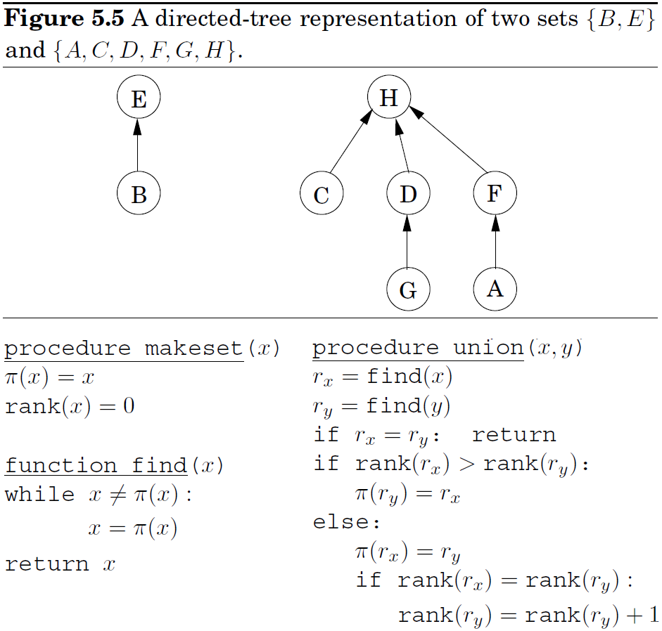
merge-find set (disjoint-set data structure)
One way to store a set is as a directed tree. Nodes are elements of the set, arranged in no particular order.
Each node has a parent pointer and also a rank representing the height of the subtree hanging from it.

Slide 9
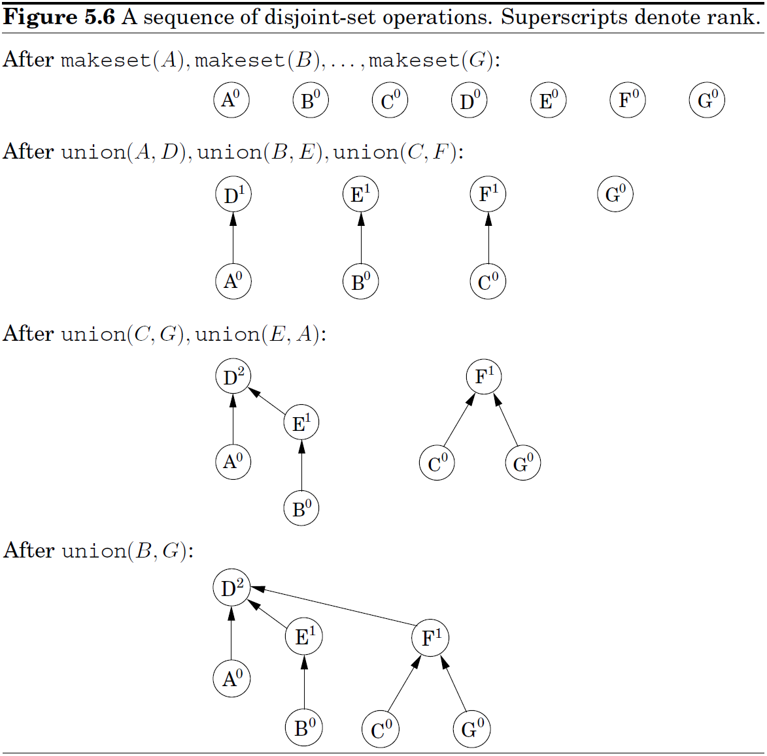
merge-find set (disjoint-set data structure)

Slide 10
merge-find set (disjoint-set data structure)
Property 1.
rank(x) is the height of the subtree rooted at that node.
Property 2. Any root node of rank k has at least 2^{k} nodes in its tree.
Merger two trees with roots of rank k-1, then we get a root node with rank k.
Induction.
Property 3. n elements, then at most n/2^{k} nodes of rank k.
the maximum rank is logn;
trees have height ≤ logn;
find(x) and union(x, y) .
Time complexity for Kruskal's algorithm
Sorting edges: O(mlogm)=O(mlogn)
m iterations: 2 find(x), 1 union(x, y), that is
If the edges are given sorted, or if the weights are small (say, O(m)) so that sorting can be done in linear time, can we perform union's and find's faster than log n?

Slide 11
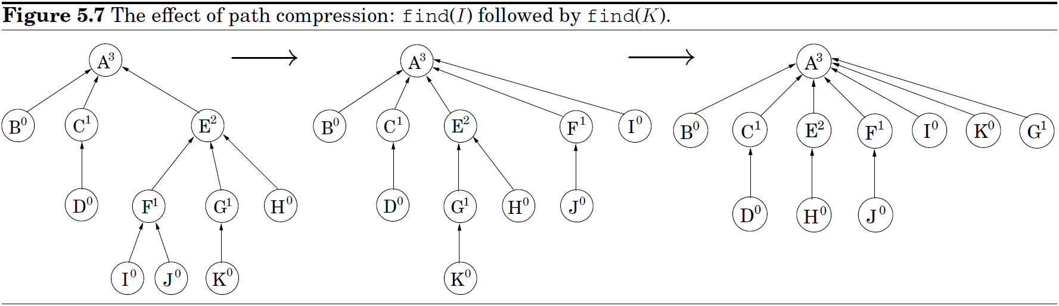
merge-find set (path compression)
Path compression: a routine maintenance for the merge-find set
function find(x)
if x ≠ π(x): π(x) = find(π(x))
return π(x)

Slide 12
merge-find set (path compression)
Path compression: a routine maintenance for the merge-find set
function find(x)
if x ≠ π(x): π(x) = find(π(x))
return π(x)
find(x): when a series of parent pointers is followed up to the root, they all point directly to the root.
find(x) only touch the insides of trees, whereas union(x, y) only look at the top level. So path compression has no effect on union(x, y) and leaves the top level unchanged.
Once a node ceases to be a root, it never resurfaces, and its rank is forever fixed. Thus the ranks of all nodes are unchanged by path compression, even though these numbers can no longer be interpreted as tree heights.
Properties 1-3 still hold.

Slide 13
merge-find set (path compression)
Time complexity: In a sequence of find(x) operations, some may take longer than others. Give each node a certain amount of pocket money, such that the total money doled out is at most nlog*n dollars.
Each find(x) takes O(log*n) steps, plus some additional amount of time that can be paid for using the pocket money of the nodes involved ― one dollar per unit of time.
The overall time for m find(x) is at most O(mlog*(n) + O(nlog*n).

Slide 14
merge-find set (path compression)
By Property 3, for n elements, their rank values .
Partition {1, …, log n} into log*n intervals.
log*n:
In practice, n ≤ 2⁶⁵⁵³⁶, so log*n ≤ 5.
A node receives its allowance as soon as it ceases to be a root, at which point its rank is fixed. If this rank lies in the interval {k+1, …, 2^{k}}, the node receives 2^{k} dollars.
By Property 3, the number of nodes with rank > k is bounded by
The total money given to nodes in {k+1, …, 2^{k}} .
There are log*n intervals, the total money disbursed to all nodes is nlog*n.

Slide 15
merge-find set (path compression)
The time taken by a specific find(x) is the number of pointers followed. Consider the ascending rank values along this chain of nodes up to the root. Nodes x on the chain fall into two categories:
(1) the rank of π(x) is in a higher interval than the rank of x,
―At most log*n nodes of this type.
(2) the rank of π(x) is in the same interval as the rank of x.
―Each node must pay a dollar for it's processing time.
Is the initial allowance of each node x enough to cover all of its payments in the sequence of find operations? Here's the crucial observation: each time x pays a dollar, its parent changes to one of higher rank. Therefore, if x's rank lies in {k+1, …, 2^{k}}, it has to pay at most 2^{k} dollars before its parent's rank is in a higher interval; whereupon it never has to pay again.

Slide 16

姚期智
姚期智(1946－)：生于上海，祖籍湖北孝感，
清华大学交叉信息研究院院长。
曾任教MIT、斯坦福、伯克利、普林斯顿。
美国计算机协会会士、国际密码协会会士、
美国国家科学院院士、中国科学院院士。
1967年，台湾大学物理学学士
1972年，哈佛大学物理学博士
1975年，伊利诺伊大学计算机科学博士
1987年，波里亚奖(George Polya Prize)
1996年，高德纳奖(Donald E. Knuth Prize)
2000年，图灵奖(A.M. Turing Award)
2021年，京都奖(Kyoto Prize)
在基于计算复杂性的伪随机数生成理论、密码学、通信复杂性、量子通信和计算等领域，做出了重要贡献。

Slide 17
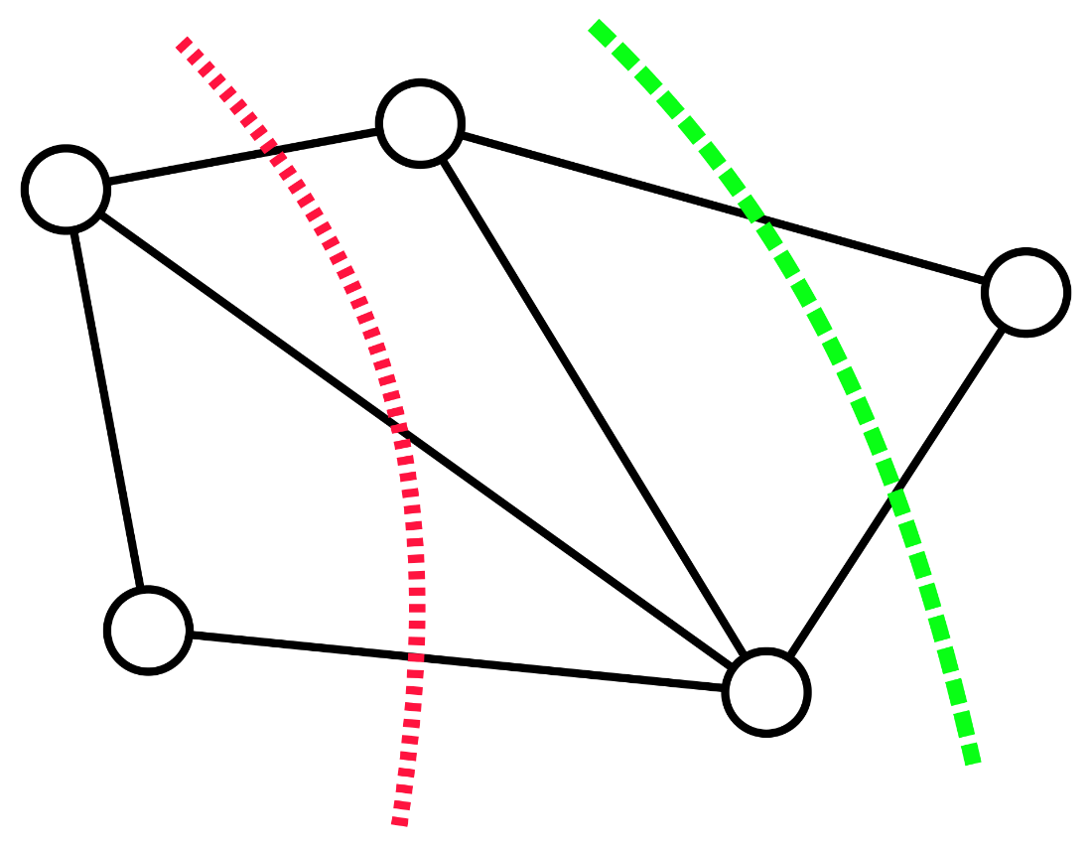
A randomized algorithm for unweighted minimum cut
Let G=(V, E) be an undirected, unweighted graph. A minimum cut S is a partition of V into S and V−S that minimizes the number of edges crossing the partition.

Slide 18
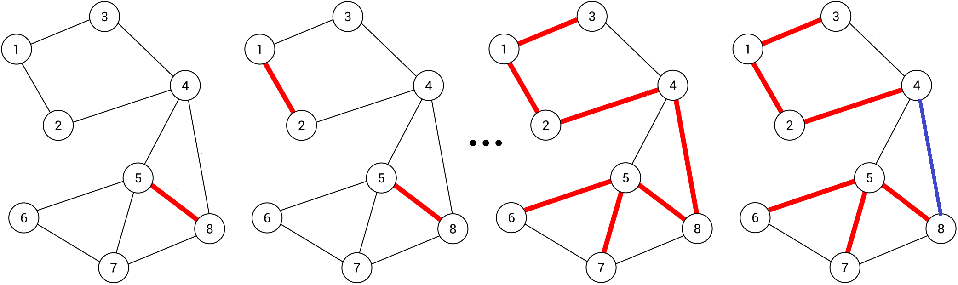
A randomized algorithm for unweighted minimum cut
Prerequisites: (1) G=(V, E) be an undirected, unweighted graph.
(2) The edges were ordered uniformly at random for Kruskal's algorithm to process them.
At any stage of Kruskal's algorithm, V is partitioned into connected components. Each component can be viewed as a cut that separated it from the rest of the graph.
Remove the last edge added to the spanning tree, thus defines a cut (S, ).

Slide 19
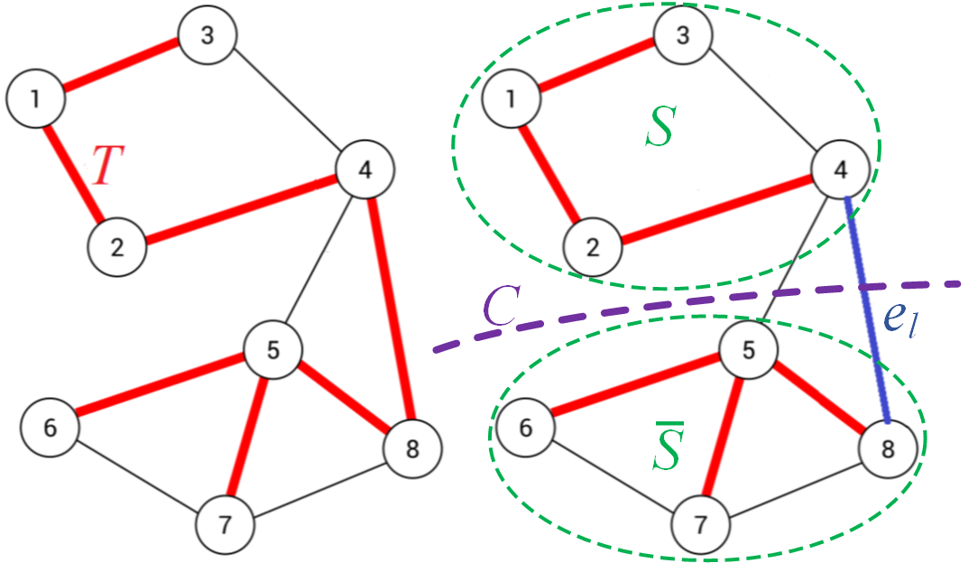
A randomized algorithm for unweighted minimum cut
Let C be a minimum cut, c its size, and T the mst Kruskal's algorithm gets. Now there are k components. Let e_{n} be the edge chosen next, e_{l} the last.
Repeating the process O(n²) times and outputting the smallest cut found yields C with high probability.
Time complexity: O(n²mlogn).

Slide 20
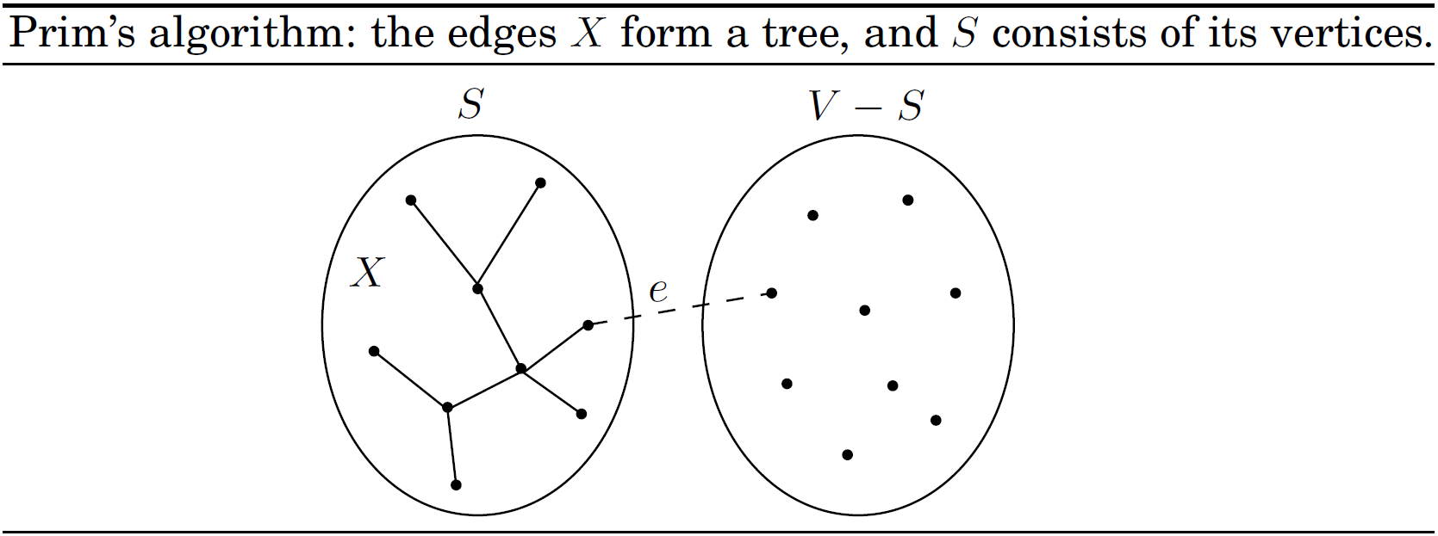
Minimum Spanning Tree
Prim's algorithm is strongly reminiscent of Dijkstra's algorithm, and in fact the pseudocode is almost identical.
Prim's algorithm always maintains a subtree. On each iteration, the subtree grows by one edge, namely, the lightest edge between a vertex in the subtree and a vertex outside it.

Slide 21
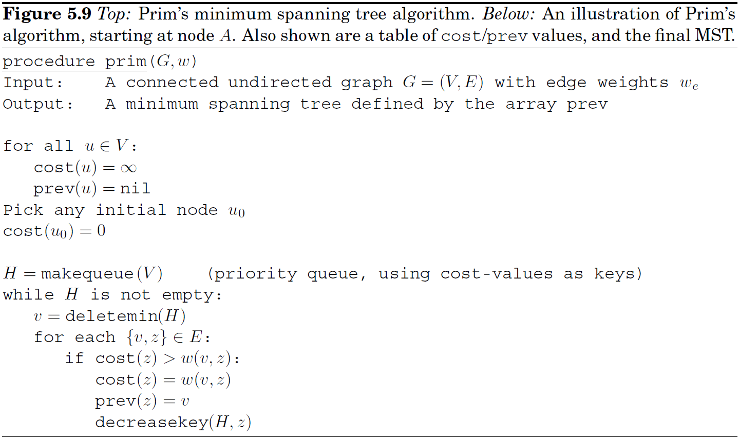
Minimum Spanning Tree
Prim's algorithm is strongly reminiscent of Dijkstra's algorithm.

Slide 22
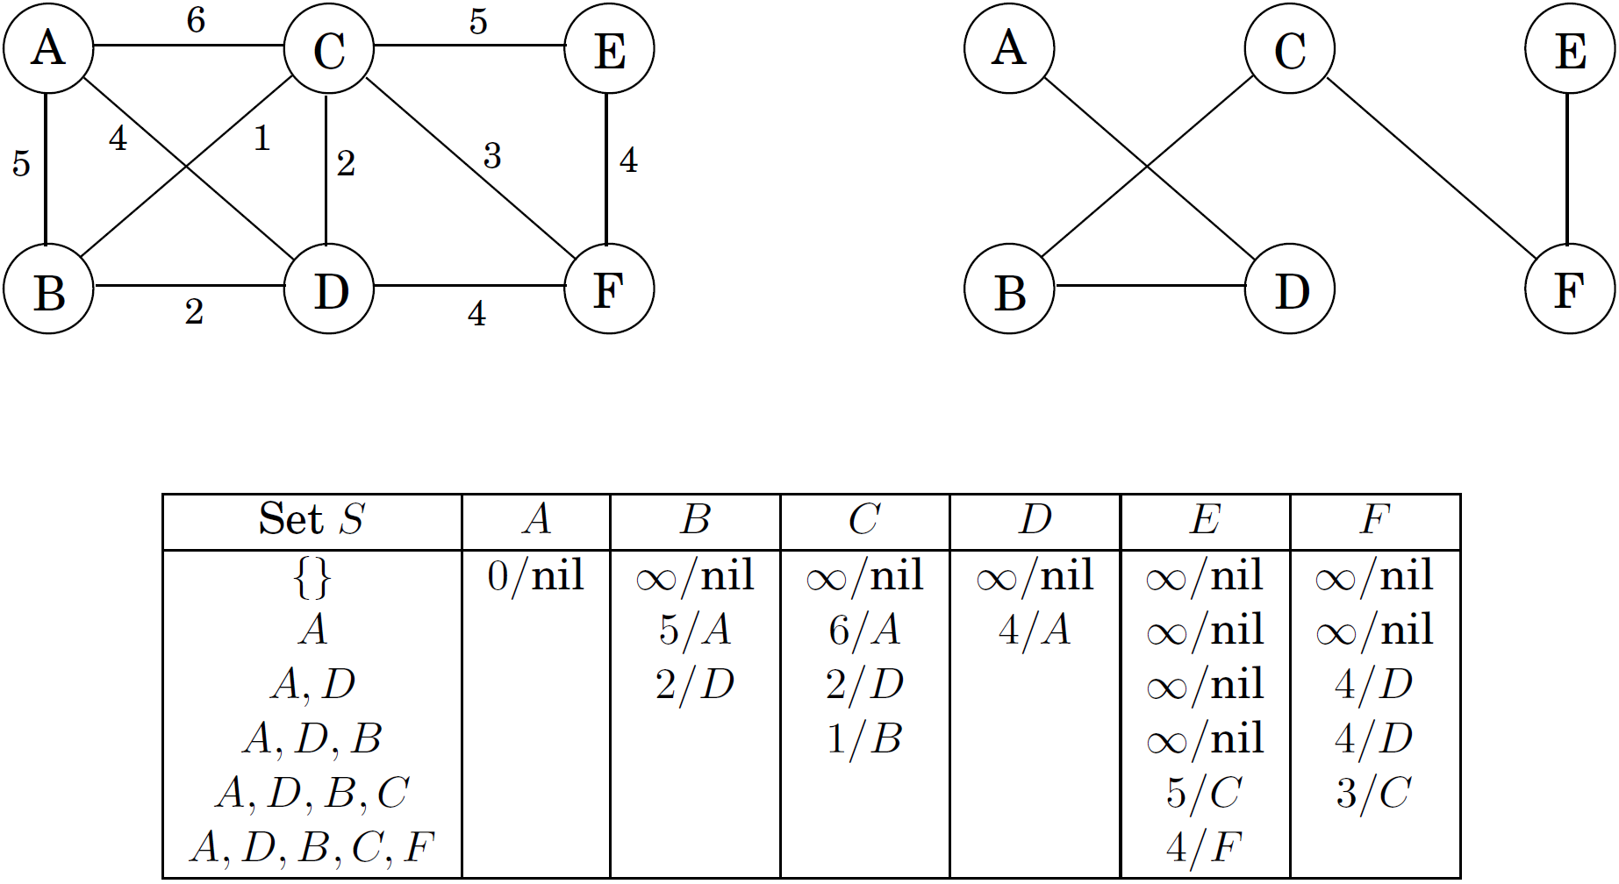
Minimum Spanning Tree
Example.

Slide 23
Horn formulas
A literal is either a variable x or its negation .
A clause is an OR of any number of negative literals.
Horn formulas are CNF made of two kinds of Horn clauses
Implications: exactly one positive literal.
singleton is a degenerate implication.
Pure negative clauses: no positive literal.
Strategy: We start with all variables false. We then proceed to set some of them to true, one by one, but very reluctantly, and only if we absolutely have to because an implication would otherwise be violated. Once we are done with this phase and all implications are satisfied, only then do we turn to the negative clauses and make sure they are all satisfied.

Slide 24
Horn formulas
A stingy algorithm for Horn formulas
set all variables to 0
while there is an implication that is not satisfied
set the right-hand variable of the implication to 1
if all pure negative clauses are satisfied
return the assignment
else
return “formula is not satisfiable’’
In the while loop, the order to scan implications is vague. When a right-hand variable is set to 1, other implications previously satisfied may become unsatisfied. But each implication is processed at most once. ?
Time Complexity: in time linear in the length of the formula.
Variable-clause incident list

Slide 25
Horn formulas
Correctness:
(1) If the algorithm returns an assignment, this assignment satisfies both the implications and the negative clauses, and so it is indeed a satisfying truth assignment of the input Horn formula.
(2) We need to convince ourselves that if the algorithm finds no satisfying assignment, then there really is none. This is so because our stingy rule maintains the following invariant:
If a certain set of variables is set to true, then they must be true in any satisfying assignment.
Hence, if the truth assignment found after the while loop does not satisfy the negative clauses, there can be no satisfying truth assignment.
Notes:
(1)显然正确。
(2)考虑一个逐步赋值而得的赋值树。每一次把0值的变量改为1值，都是不得已而为之。且对任何赋值均需如此。
若本算法所得赋值未能满足原CNF，则能做变动的就是把更多的变量由0改1.
但是这样只能使得纯否定子句更加不满足。

Slide 26
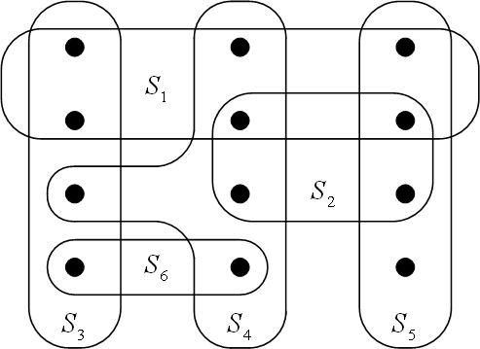
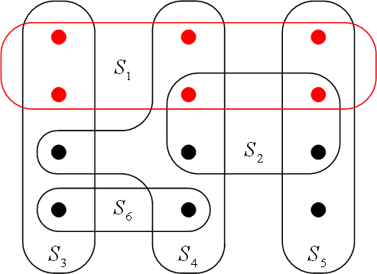
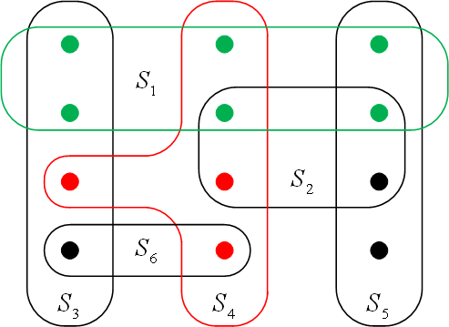
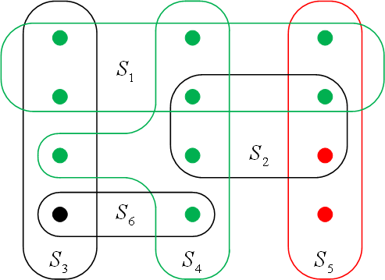
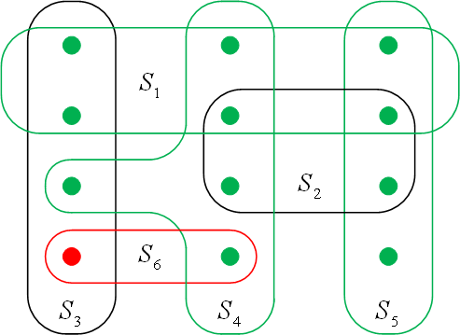
Set Cover
Set Cover
Input: A set of elements B; sets
Output: A selection of the S_{i} whose union is B.
Cost: Number of sets picked.
A greedy approximation algorithm:
Pick the set S_{i} with the largest number of uncovered elements.

Slide 27
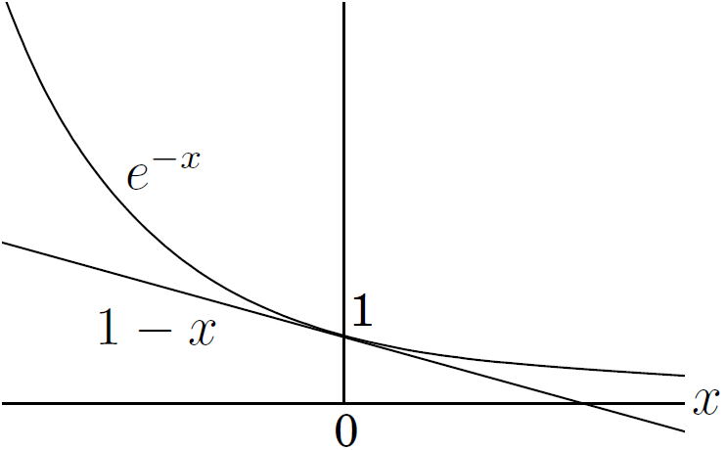
Set Cover
Theorem. Suppose B contains n elements and that the optimal cover consists of k sets. Then the greedy algorithm will use at most klnn sets.
Proof. Let n_{t} be the number of elements still not covered after t iterations (n₀=n). Since these elements are covered by the optimal k sets, there must be some set with at least n_{t}/k of them. So the greedy strategy will ensure
that , which implies .
Further more, because ,
At t =klnn, n_{t}<ne^{-lnn} =1, which means no elements remain to be covered.

